Slide 1
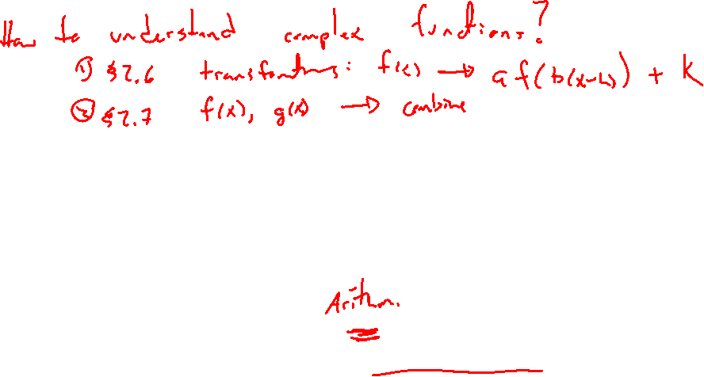
Section 2.7 Combining Functions
Lecture 1
Basic combinations
Intro function composition

Slide 2

Section 2.7 Homework Submission to Canvas
Preview of section
Skim the section in text and write a short paragraph summary.
Give a bulleted list of all important definitions, theorems, and formulas without details.
Notes on video lectures
Take notes on everything written on slides including all details, worked examples, on-own activities, as well as your own thoughts and questions.
Try on-own activities first, then write down provided solution next to it for comparison.
Worked examples from the text
Write down the problem and attempt without looking at the solution.
Use the solution to write the best explanation you can.
Solutions to textbook exercises
Model approaches and explanations given in the video lectures and textbook examples.
Final reflection of section
List the key takeaways to remember as a bulleted list.

Slide 3
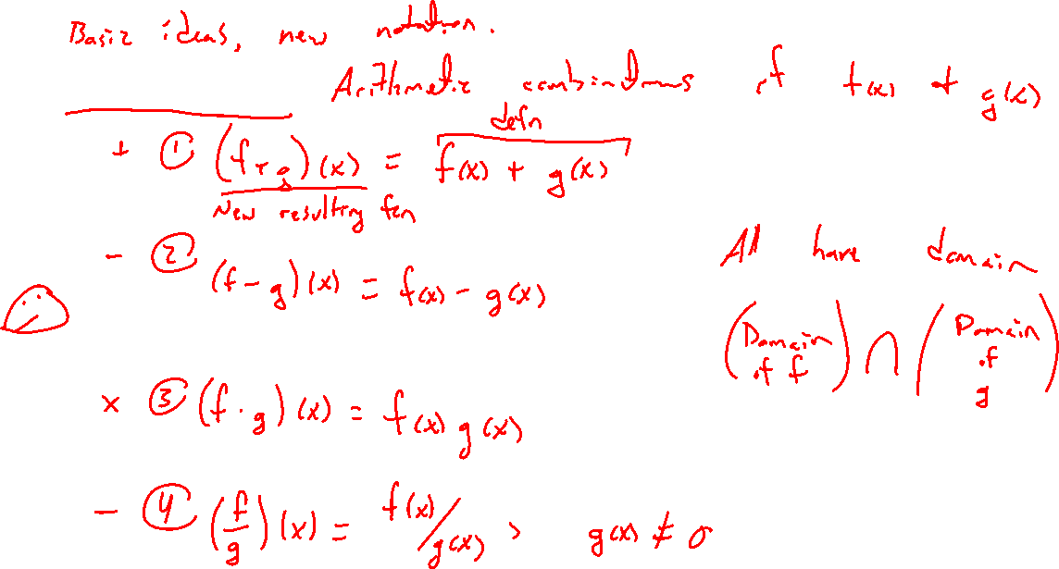
Definitions
Notes:
F+g, f-g, f \cdot g, f/g
Only new is notation, take care
Domain if Df \intersect Dg, avoid zero division

Slide 4
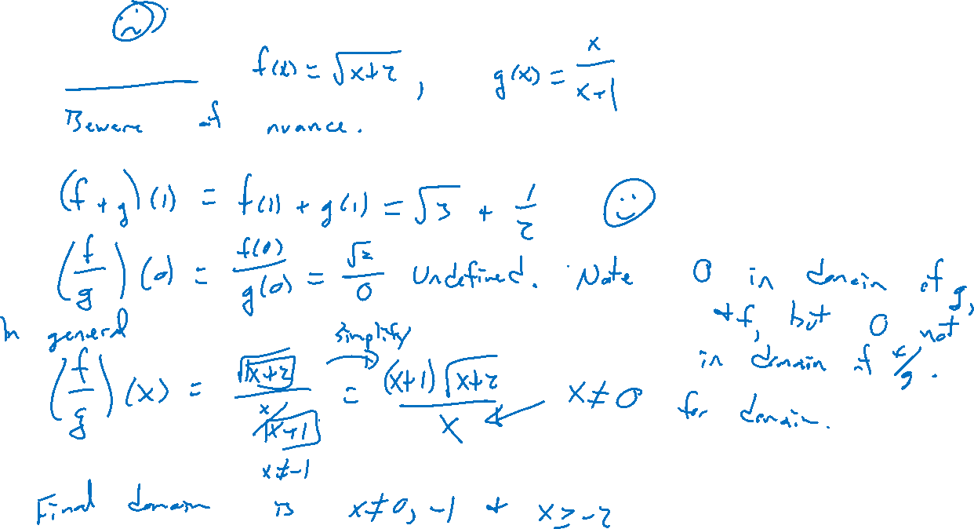
Example
Notes:
F(x)=\sqrt{x+2}, g(x) = x/(x+1)
(f+g)(1), (f/g)(0)
Do f/g(x) in general. Keep track of domain changes and compare to Df \intersect Dg, avoid zero division

Slide 5
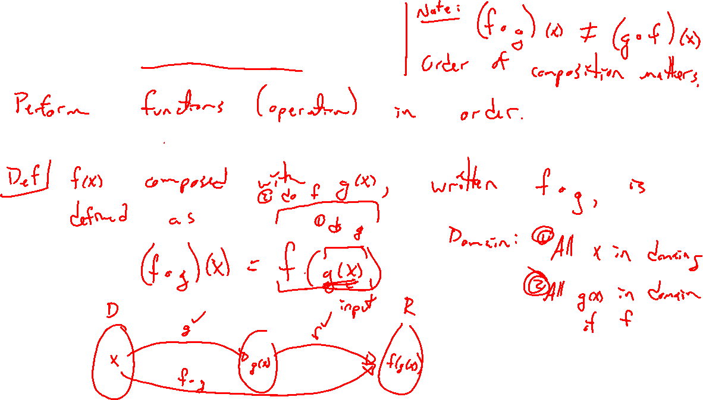
Function Composition Idea
Notes:
Basic arithmetic operations bit boring. Simple, notation just shorthand.
Doing functions in order more interesting.
(f \circ g)(x) = f(g(x)), draw diagram, relay race.
Do an operation first, apply to the result.

Slide 6
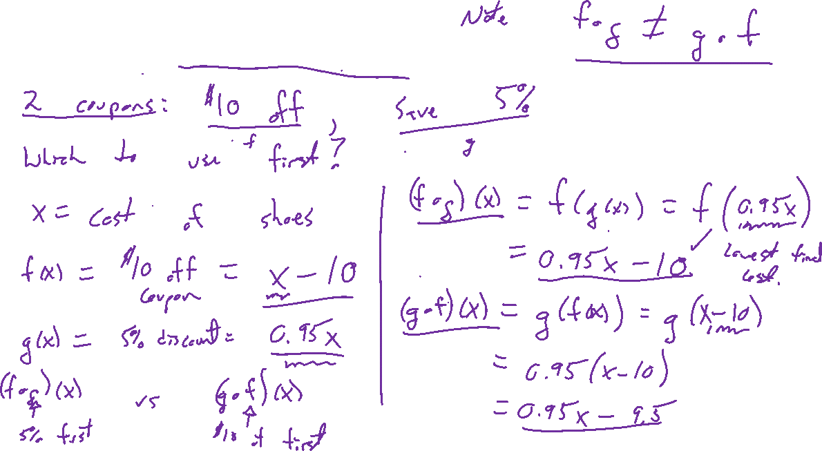
Example: Savy Shopping
Notes:
10$ off. 7% discount. Which to use first? Let x be the cost of thing.
Write as two functions: f(x) = x-10, g(x) = 0.97x
F(g(x)) vs g(f(x)).

